Slide 1
Chapter 18
Network Hardening Techniques

Slide 2
Best Practices
Secure SNMP
Version 1 and 2 are deprecated
Version 3
Offers Authentication and encryption for traffic between devices and SNMP Server
Router Advertisement (RA) Guard
Ipv6 Uses in neighbor discovery
Can be captured and spoofed
Compares switch configuration info with received RA frame
If not validated frame is dropped
Port security
Static
Dynamic
Dynamic ARP inspection
Uses information in the DHCP snooping database to verify MAC address mappings
Frames with incorrect mappings or altered mappings are dropped
Private VLANs
Subsection of a VLAN
Used to isolate systems within that VLAN
Notes:
Secure SNMP: Utilize Version 3 because supports strong authentication w/ encryption and data integrity
Router Advertisement Guard: To protect your routers from Rogue or unsolicited RA messages that utilize Neighbor Discovery Protocol to communicate with neighbor routers
Port Security: Helps prevent hackers from using a port on a switch or router to gain access to your network
Dynamic ARP Inspection: Verifies the IP-to-MAC address mapping of each frame going through the switch to protect against MAC spoofing
Private VLANs: Makes sure that those ports on the private ports are isolated and are restricted to communicate over only one specificed trunking port

Slide 3
Best Practices
Disable unneeded switchports
Disable unneeded network services
Change default passwords
Password complexity/length
Enable DHCP snooping
Configured on switch access ports
Allows responses to client request from trusted ports
Builds a binding table and alerts the switch to mapping that don’t match the table
IP to MAC table by snooping on legitimate DHCP traffic
Notes:
Disable all unneeded switchports to prevent the connection of a rogue device into an unused wall outlet
Disable unneeded network services: disabling all ports on a DNS server to just port 53
Enable DHCP snooping: stops the annoyance of users not being able to connect to the internet and is vulnerable to several types of attacks

Slide 4
Best Practices
Change default VLAN
Patch and firmware management
Rollback
Firmware Updates
Driver Updates
Access control list
Role-based access
Notes:
Change default VLAN: you cant delete the default, but you can create a new VLAN or several and move all switch ports to that VLAN
Firmware updates: is flashing the BIOS, main thing is to maintain power
Access Control List: Good to have for network security
Role-Based Access: easier to have as an administrator to add or remove policies and permissions from users

Slide 5
Best Practices
Firewall rules
Explicit deny
Implicit deny
Wireless security
MAC filtering
Antenna placement
Power levels
Wireless client isolation
Guest network isolation
Pre-shared keys (PSKs)
Geofencing
Captive portal
Notes:
Explicit deny: all traffic is allowed unless it is EXPLICITY denied with a rule (Blacklisting)
Implicit deny: all traffic is denied unless it is IMPLICITLY allowed by a rule (Whitelisting)
Guest network isolation: has two networks, the guest network has wireless client isolation and the other network is for your users
Geofencing: A network and its data’s access is limited to a specific geographic area
Captive Portal: when you get on Hotel WiFi, the page that pops up asking you to agree to their terms & conditions prior to gaining access to the internet

Slide 6
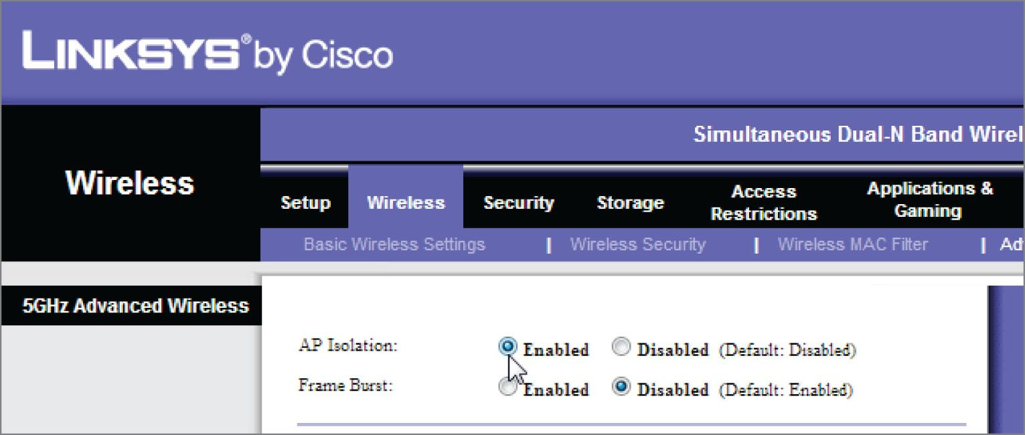
Wireless Client Isolation
Wireless stations within an SSID can only access the Internet.
Figure 18.5: Isolation
Notes:
A security feature that prevents devices from being able to communicate with one another

Slide 7
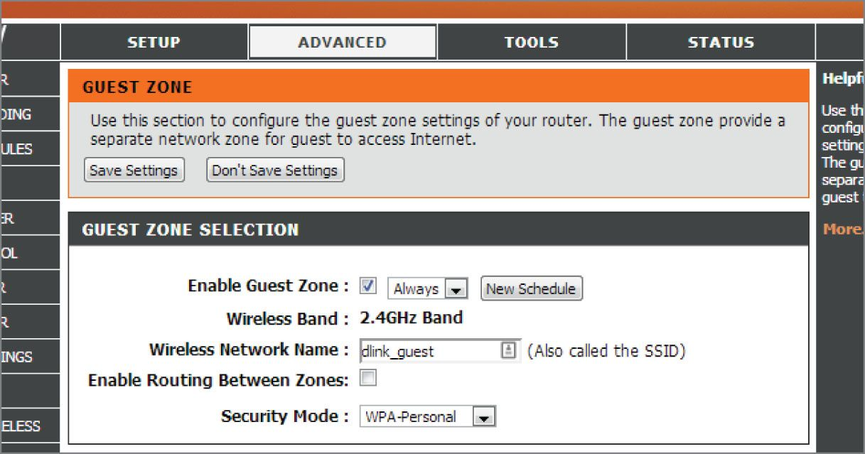
Guest Network Isolation
Guests who join the guest Wi-Fi network are confined to an entirely separate network and given Internet access, but they can’t communicate with the main wired network or the primary wireless network.
Figure 18.6: Guest network

